Slide 1
Asexual Reproduction
Reproduction in which a new organism is produced from one organism

Slide 2
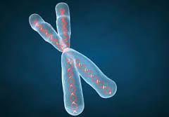
Chromosome
Structures in the nucleus that contain hereditary material

Slide 3
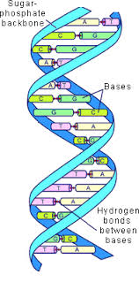
DNA
Coded instructions that control cell activity

Slide 4
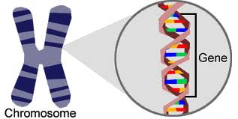
Gene
Segment of DNA on a chromosome

Slide 5
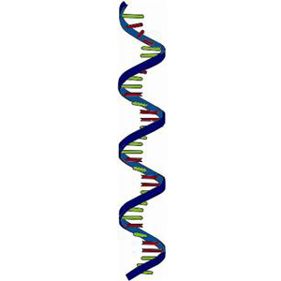
RNA
A nucleic acid which carries the code for making proteins from the nucleus to the ribosomes

Slide 6
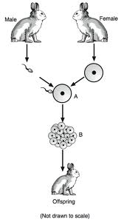
Sexual Reproduction
Reproduction in which a new organism is produced when sex cells combine

Slide 7
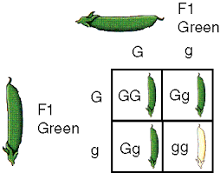
Genotype
The entire genetic makeup of an organism
GG, Gg, gg
⬆

Slide 8
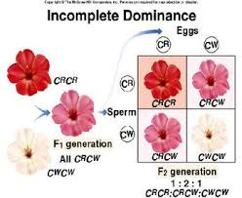
Incomplete Dominance
When one trait is not completely dominant over another
⬆

Slide 9
Phenotype
An organism’s appearance
Physical Features
Green, White
⬆
⬆

Slide 10
Probability
The mathematical Chance that something will happen
Parents Genotypes ⬇ ➔ | G | g
G | GG | Gg
g | Gg | gg
¼ GG=25%
½ Gg=50%
¼ gg=25%

Slide 11
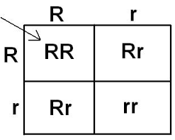
Punnett Square
A way to organize possible offspring combinations

Slide 12
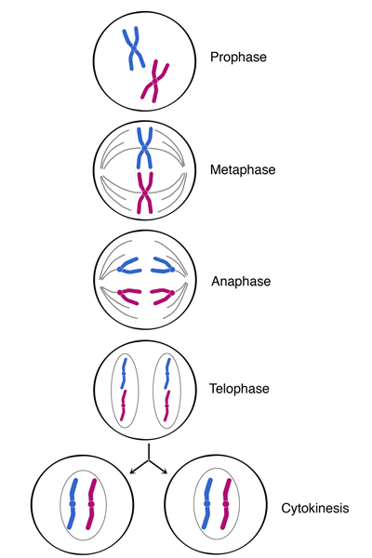
Mitosis
Makes body cells
Occurs in both plants and animals
Has 4 steps in cell division

Slide 13
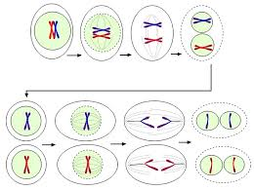
Meiosis
Makes sex cells
Produces new cells with each having half (1/2) as many chromosomes as the original cell
Occurs in both plants and animals
Has 8 steps in cell division

